Slide 1



CNN in Keras
Keras provides data sets loading function:
http://keras.io/datasets/
Very flexible
or
Need some effort to learn
Easy to learn and use
Interface of TensorFlow or Theano
(still have some flexibility)
keras
You can modify it if you can write TensorFlow or Theano
Notes:
適合初學者
台大上課
太過 ＯＰ
Toolkit

Slide 2
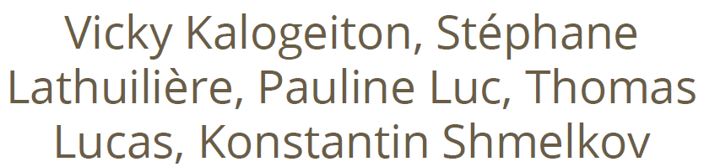
Keras: strengths
● Easy-to-use Python library
● It wraps Theano and TensorFlow (it benefits from the advantages of both)
● Guiding principles: modularity, minimalism, extensibility, and Python-nativeness
● Why python? Easy to learn, powerful libraries (scikit-learn, matplotlib...)
● Many easy-to-use tools: real-time data augmentation, callbacks (Tensorboard visualization)
● Keras is gaining official Google support

Slide 3
Keras: Weakness
● Less flexible
● No RBM for example
● Less projects available online than caffe
● Multi-GPU not 100% working

Slide 4
Install Tensorflow
https://www.tensorflow.org/install/
Mac: open Terminal window
$ pip install tensorflow
Windows: open Anaconda Prompt window
$ pip install tensorflow

Slide 5
Install Keras
Mac: open command window
$ pip install keras
Windows: open Anaconda Prompt window
$ pip install keras
Then in Rodeo, use the code:
import keras
print (keras.__version__)

Slide 6


CNN in Keras
Only modified the network structure and input format (vector -> 3-D tensor)
input
Convolution
1 | -1 | -1
-1 | 1 | -1
-1 | -1 | 1
-1 | 1 | -1
-1 | 1 | -1
-1 | 1 | -1
There are 25 3x3 filters.
……
Max Pooling
Input_shape = ( 28 , 28 , 1)
28 x 28 pixels
1: black/white, 3: RGB
Convolution
3
-1
3
Max Pooling
-3
1

Slide 7
CNN in Keras
Only modified the network structure and input format (vector -> 3-D array)
Input
1 x 28 x 28
Convolution
How many parameters for each filter?
9
25 x 26 x 26
Max Pooling
25 x 13 x 13
Convolution
How many parameters
for each filter?
225=
25x9
50 x 11 x 11
Max Pooling
50 x 5 x 5

Slide 8
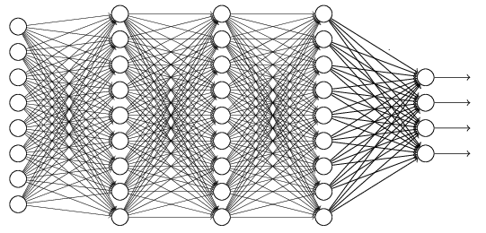
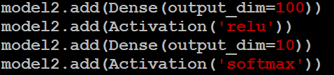
CNN in Keras
Only modified the network structure and input format (vector -> 3-D array)
Input
1 x 28 x 28
Output
Convolution
25 x 26 x 26
Fully connected feedforward network
Max Pooling
25 x 13 x 13
Convolution
50 x 11 x 11
Max Pooling
1250
50 x 5 x 5
Flattened

Slide 9
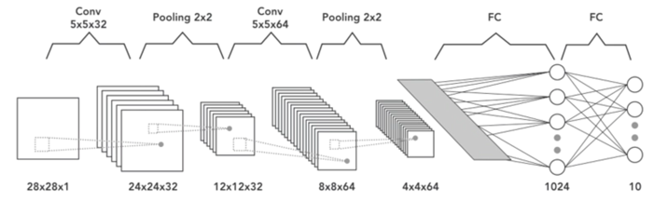
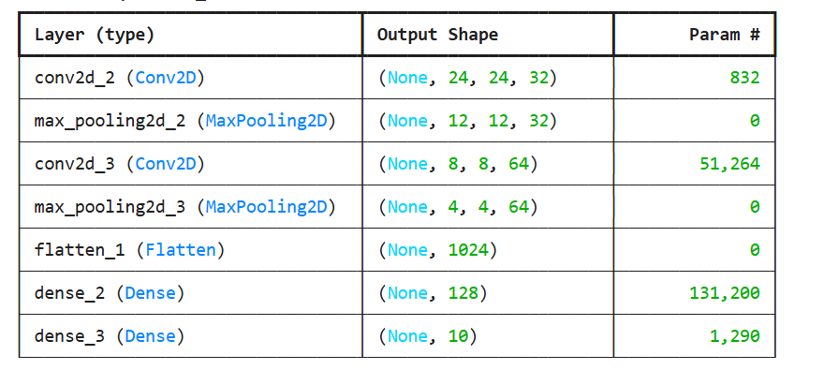
Build a CNN in Keras with the following specs:
Input: 28×28 grayscale image
Conv1: 32 filters, kernel size 5×5
Conv2: 64 filters, kernel size 5×5
Fully connected (dense) layer
Final dense layer with 10 outputs (softmax)

Slide 10
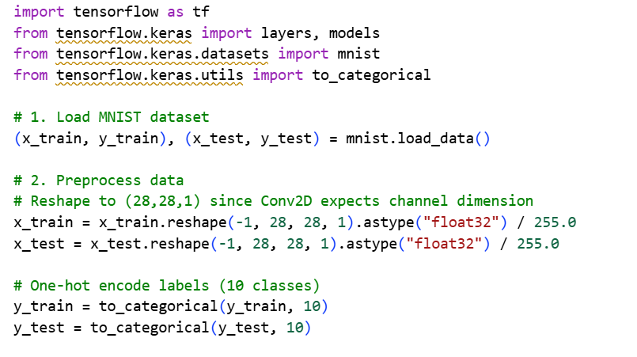
Build the CNN
Data normalization: Divided by 255.0 → values in [0,1] for stable training.
Reshape: Added channel dimension (28,28,1) for grayscale input.
One-hot encoding: Labels converted into 10-dimensional vectors for softmax.

Slide 11
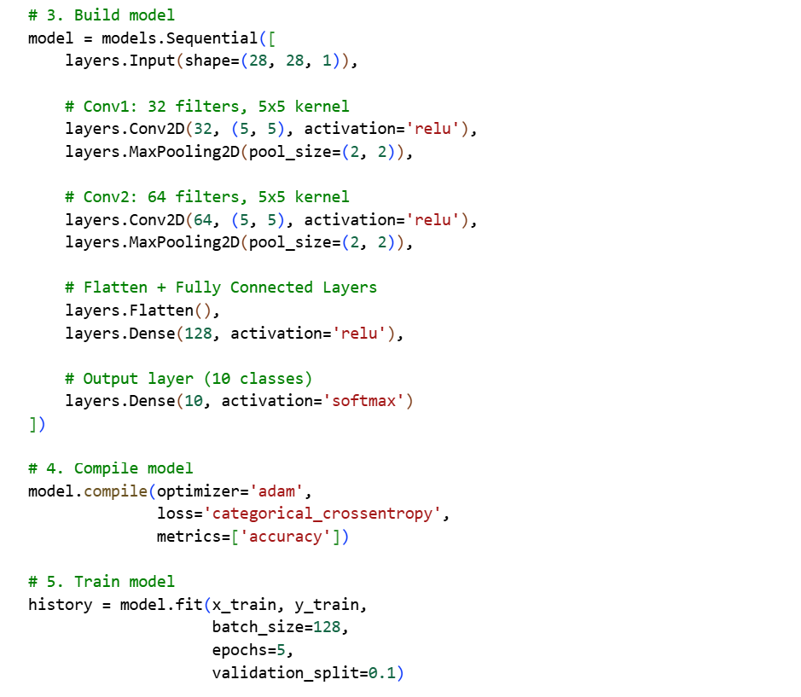
Training: 5 epochs with batch size 128
Expected accuracy: ~98% on MNIST test set after training.

Slide 12
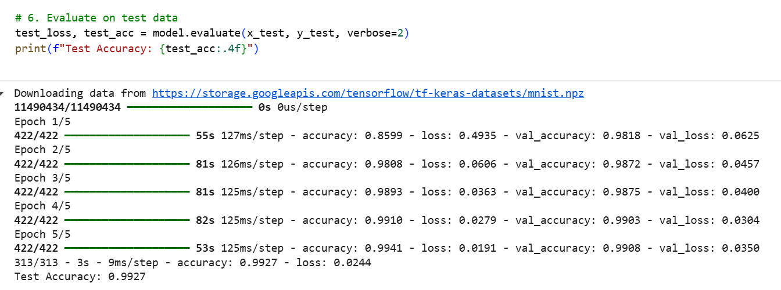
Evaluate

Slide 13
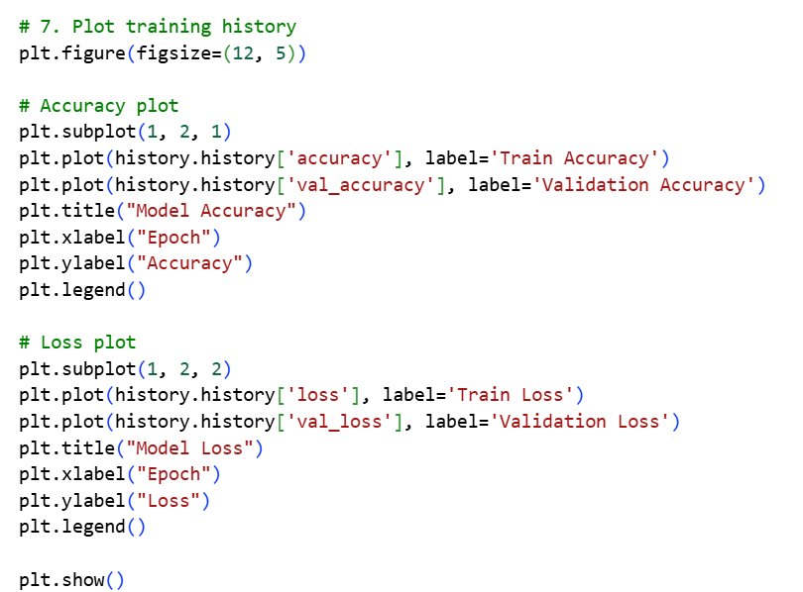
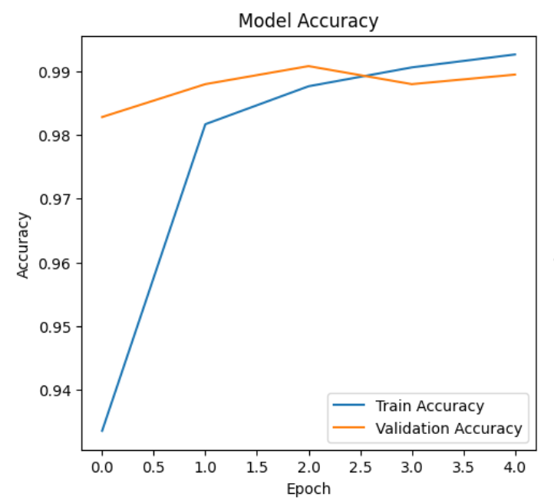
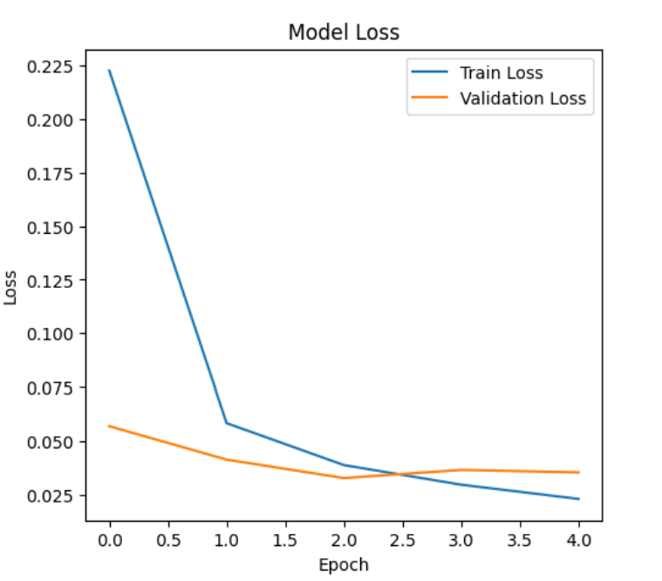
Plotting training & validation curves

Slide 14
Add Dropout
Dropout(0.25) → after conv + pooling blocks.
Dropout(0.5) → before final dense softmax layer.
Training epochs increased to 10 to let dropout take effect.

Slide 15
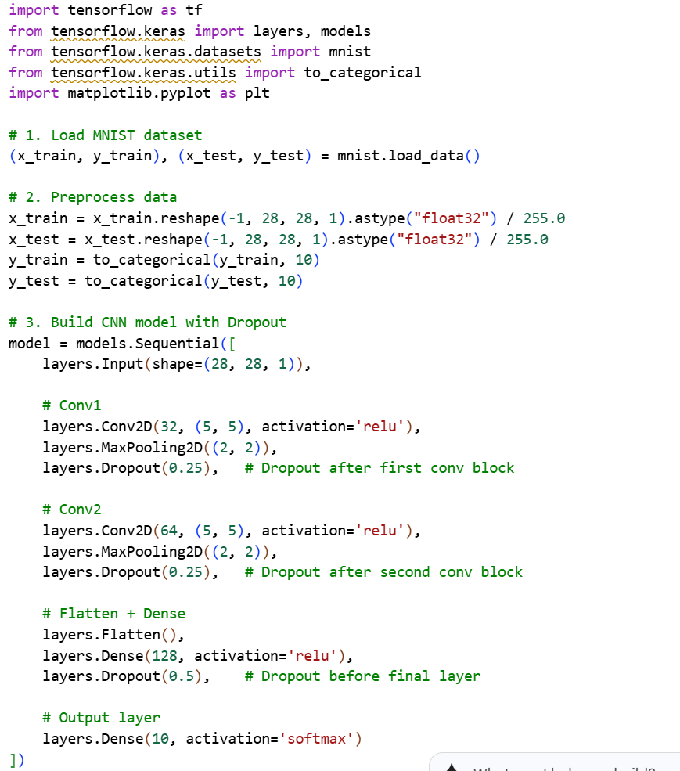
Dropout(0.25)
Dropout(0.25)
Dropout(0.5)

Slide 16
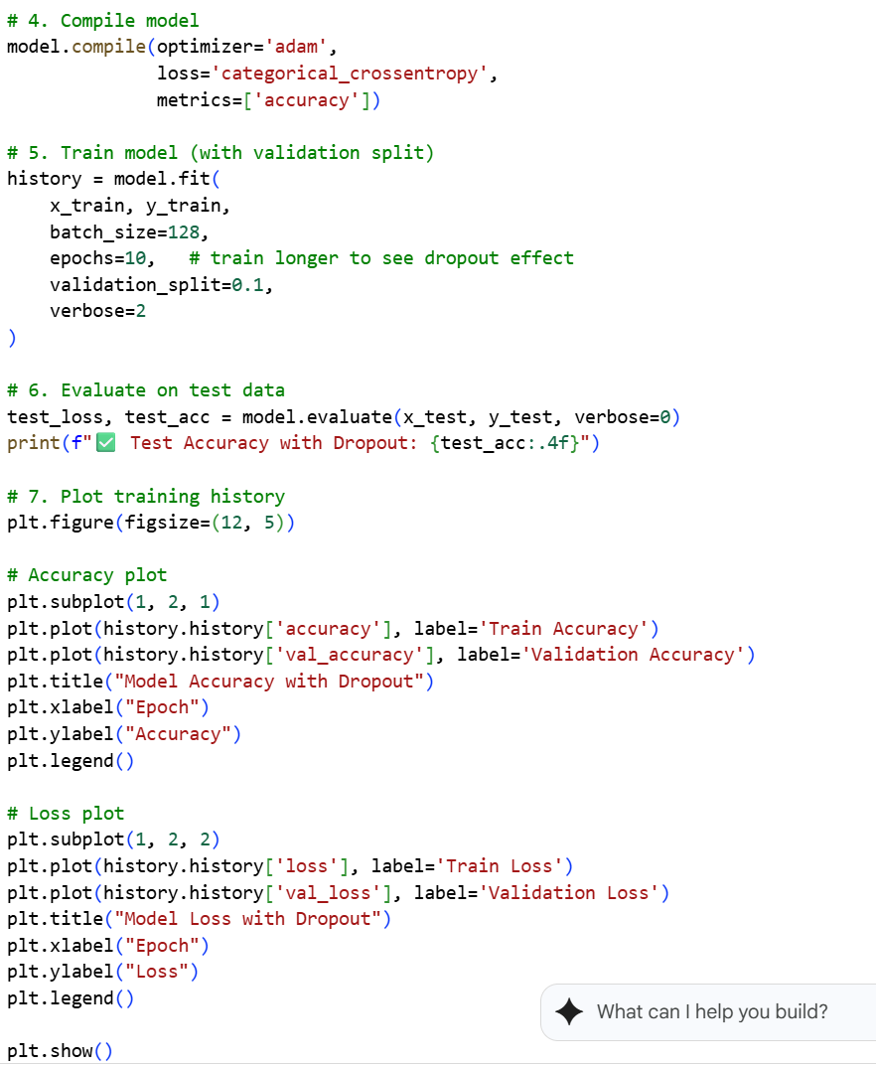
Epochs change from 5 to 10

Slide 17
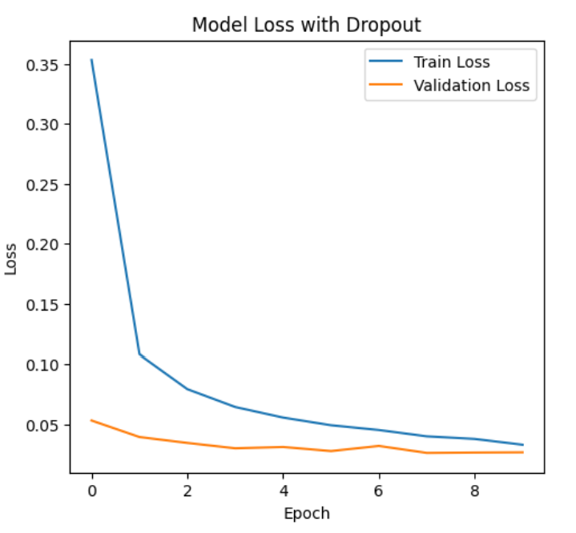
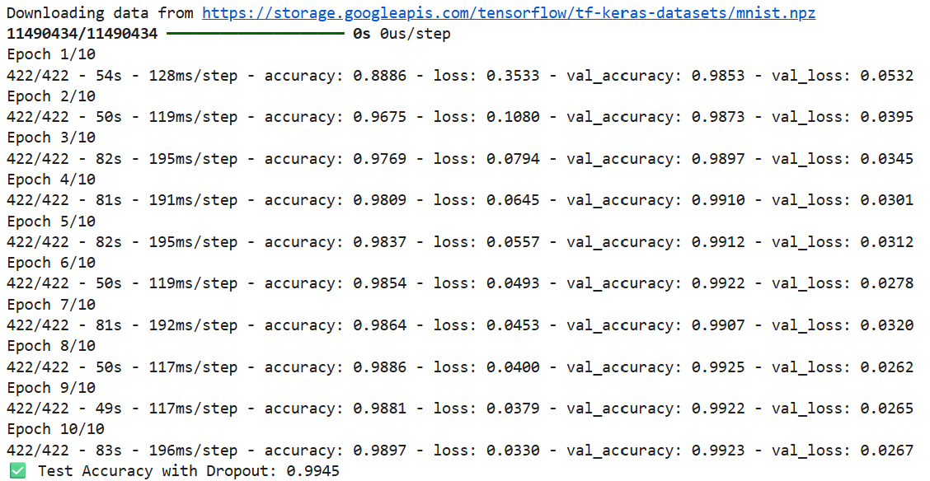
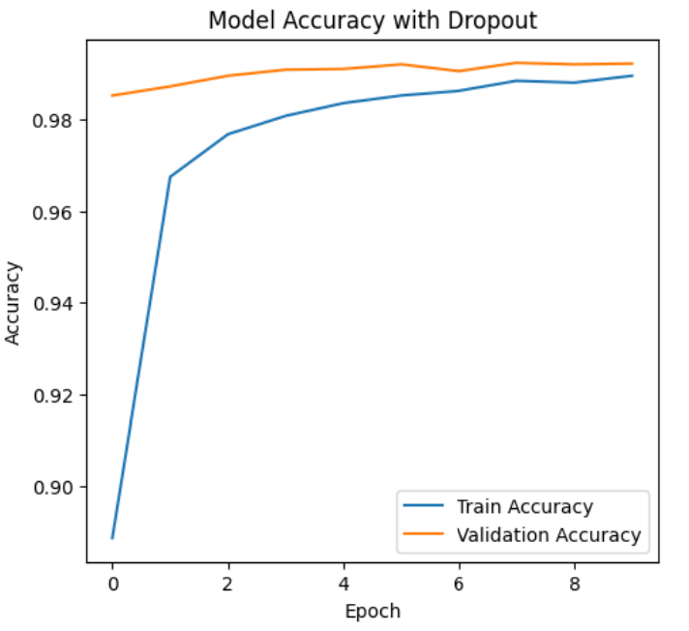
Slower training accuracy (since neurons are randomly dropped), but better validation/test accuracy ➔improved generalization.

Slide 18
Benefits of dropout
Prevents Overfitting :CNNs have millions of parameters and can easily memorize training data.
➔Dropout forces the network to not rely too heavily on specific neurons, reducing overfitting and improving generalization.
Encourages Redundancy in Feature Learning: Since neurons are randomly dropped, the network is forced to learn multiple independent representations of features (e.g., edges, textures, shapes)➔ more robust.
Acts Like Model Averaging (Ensemble Effect):Each forward pass with dropout effectively samples a different sub-network.
➔During inference (when dropout is off), the full network behaves like an ensemble of many smaller networks, improving accuracy.
Improves Robustness:The CNN becomes less sensitive to noise in the input, since it has learned more distributed, redundant feature detectors.
Efficient Regularization :Compared to L1/L2 weight regularization, dropout is simple to implement, computationally cheap, and often more effective for deep CNNs.
Encourages Sparse Representations:By zeroing out neurons, dropout introduces sparsity in activations, which can lead to more efficient representations.

Slide 19
What is Image Augmentation?
Image augmentation means artificially increasing the size and diversity of your dataset by applying random transformations to training images (e.g., rotation, flipping, zooming).

Slide 20
Benefits of data augmentation
Prevents Overfitting
CNNs often memorize training data if it’s small.
Augmentation creates new variations → model sees more diverse examples → better generalization.
Improves Robustness
Real-world images may be rotated, shifted, zoomed, or noisy.
Augmentation teaches the CNN to handle such variations.
Reduces Need for Large Datasets
Collecting and labeling thousands of images is expensive.
Augmentation "synthesizes" new data, reducing dependency on large datasets.
Improves Accuracy
A model trained on varied images (augmented) usually performs significantly better on test/unseen data.
Domain-Specific Adaptation
You can mimic real-world distortions specific to your domain.
Example: For medical imaging, adding brightness/contrast changes helps with varying scan conditions.

Slide 21

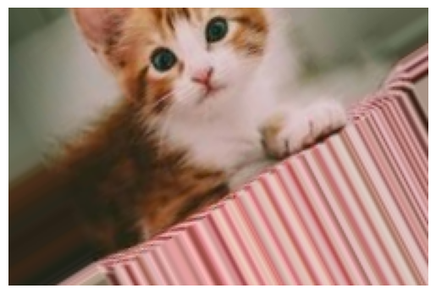
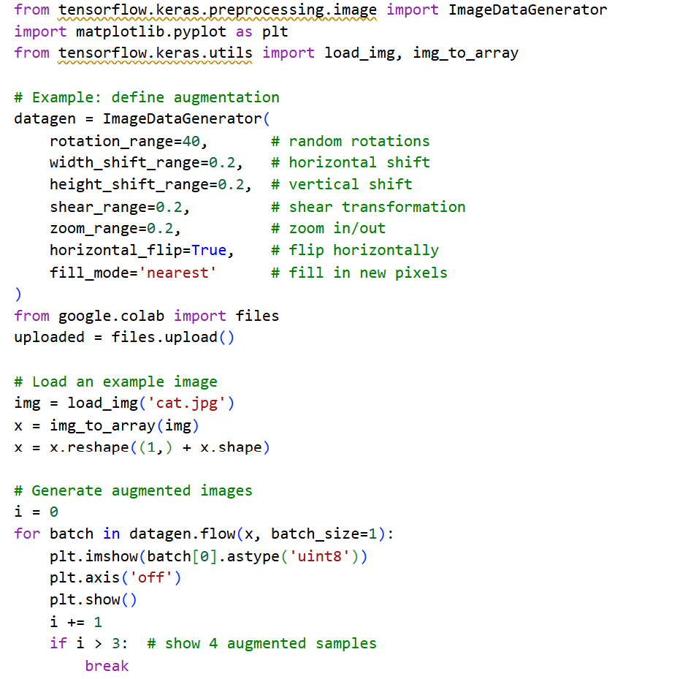
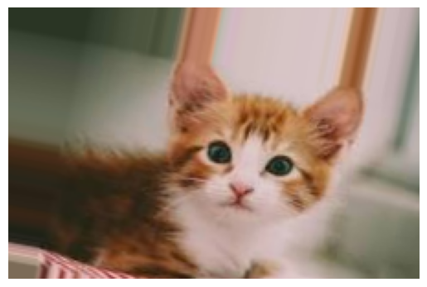
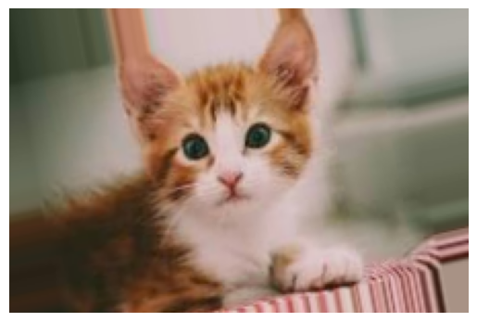
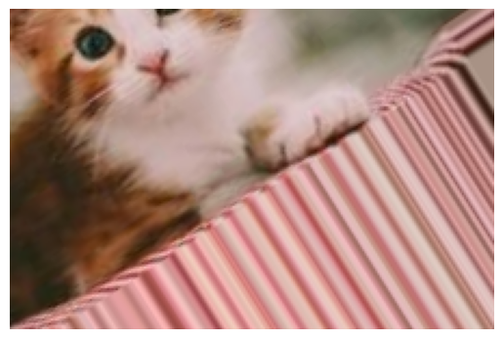

Slide 22
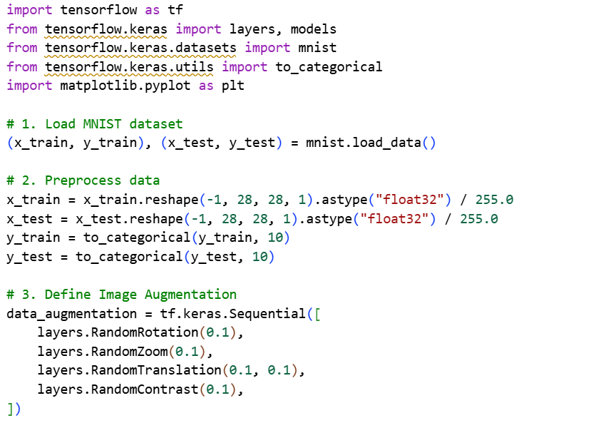
If dataset is small or noisy=>Augmentation +Dropout

Slide 23
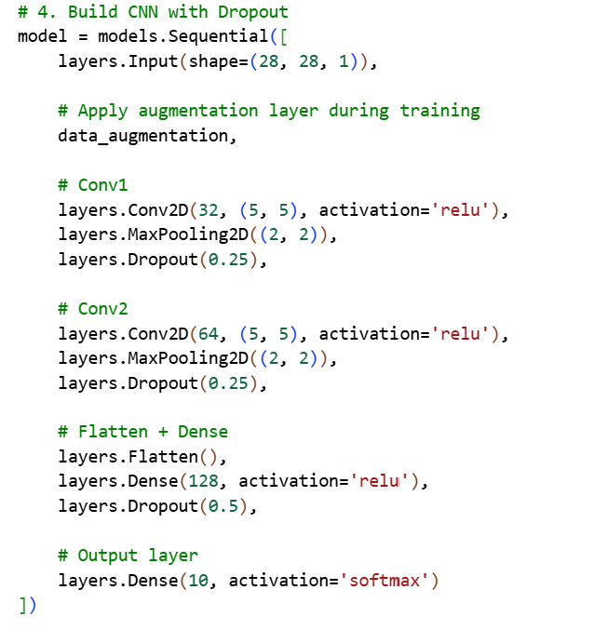
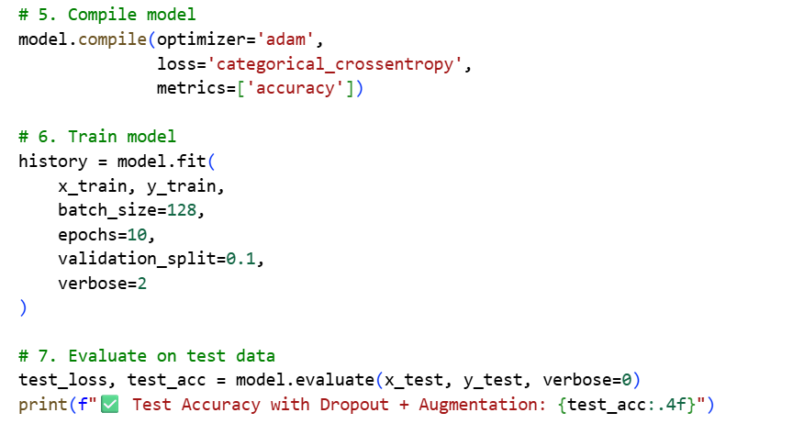

Slide 24
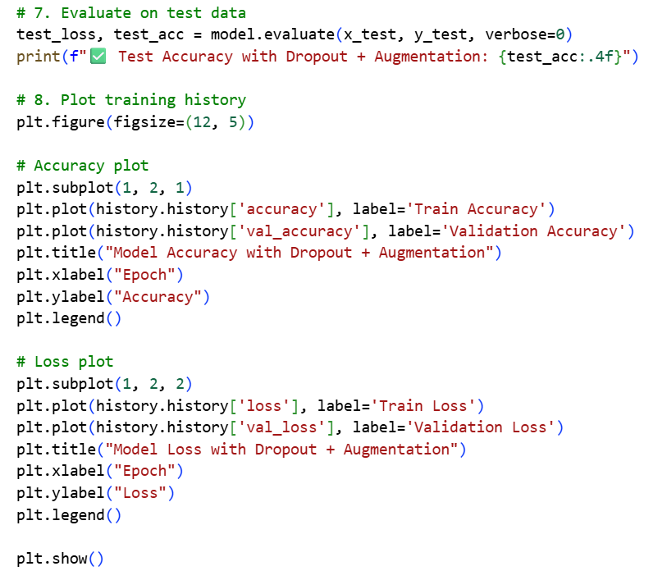

Slide 25
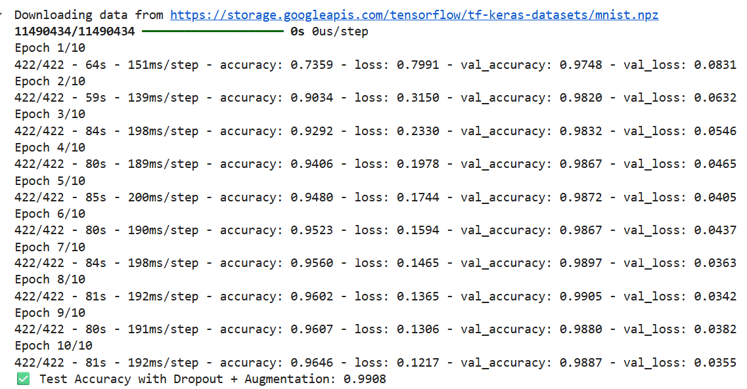
Slow (# of parameters around 11millions)

Slide 26
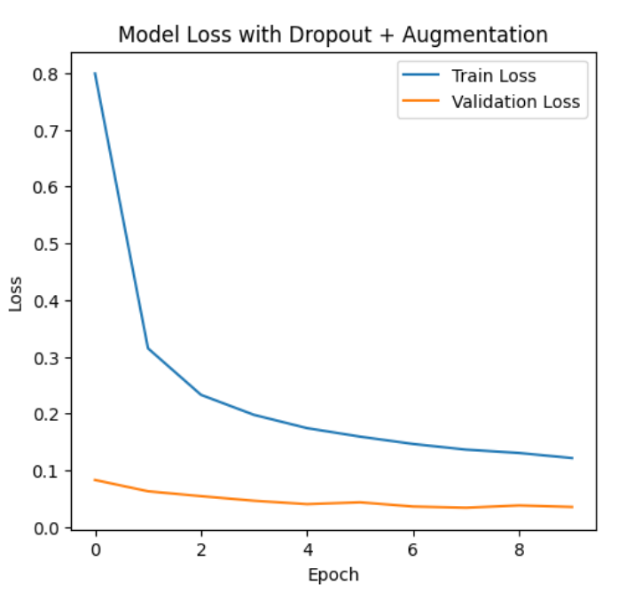
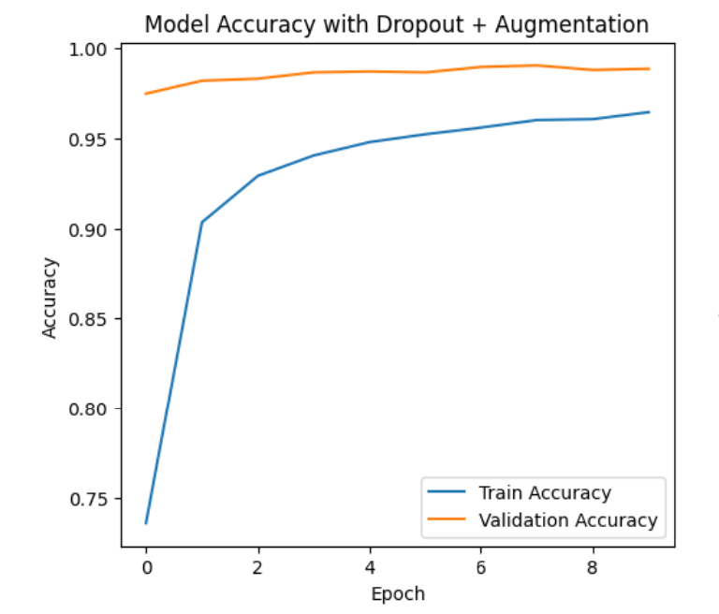

Slide 27














Mini-batch
We do not really minimize total loss!
Randomly initialize network parameters
x¹
NN
y¹
Pick the 1st batch
Mini-batch
NN
Update parameters once
x³¹
y³¹
……
Pick the 2nd batch
NN
Update parameters once
x²
y²
…
Until all mini-batches have been picked
Mini-batch
x¹⁶
NN
y¹⁶
……
one epoch
Repeat the above process
Notes:
Each time we update parameters, we have different target -> 不安
Shuffle data, and repeat above process

Slide 28







Mini-batch
Batch size influences both speed and performance. You have to tune it.
Pick the 1st batch
x¹
NN
y¹
Mini-batch
x³¹
NN
y³¹
Update parameters once
……
Pick the 2nd batch
100 examples in a mini-batch
Update parameters once
Batch size = 1
…
Until all mini-batches have been picked
Stochastic gradient descent
Repeat 20 times
one epoch
Notes:
Let’s try it.
If Batch size=1, then it is SGD.

Slide 29
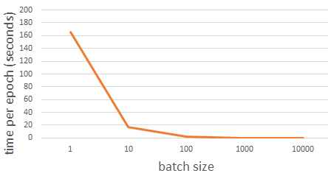
Speed
Very large batch size can yield worse performance
Smaller batch size means more updates in one epoch
E.g. 50000 examples
batch size = 1, 50000 updates in one epoch
batch size = 10, 5000 updates in one epoch
166s
1 epoch
17s
10 epoch
166s
Batch size = 1 , update the same number of times in the same period.
Batch size = 10 is more stable, converge faster
17s
GTX 980 on MNIST with 50000 training examples
Notes:
GPU has limitation. So batch size can’t be too large

Slide 30


Review: Speed - Matrix Operation
……
y₁
W¹
W²
W^{L}
……
y₂
b¹
b²
b^{L}
……
……
……
……
……
x
a¹
a²
y
……
y_{M}
y
x
Forward pass
(Backward pass is similar)
W^{L}
…
W²
W¹
x
b¹
b²
…
b^{L}
+
+
+
Notes:
Draw it?
GPU computation.

Slide 31











Speed - Matrix Operation
SGD (true stochastic): Updates weights using one training sample at a time.
Mini-batch gradient descent: Updates weights using a small batch of samples (say 32, 64, 128).
Why mini-batch is faster than stochastic gradient descent?
Stochastic Gradient Descent
=
=
……
Mini-batch
matrix
Practically, which one is faster?
=
Notes:
SGD (batch size=1)

Slide 32
Why Mini-batch is faster than SGD
(a) Vectorization and Parallelization on GPUs
CNN operations (convolutions, matrix multiplications) are highly optimized for vectorized operations on GPUs/TPUs.
If you process one sample at a time (SGD), you don’t fully utilize GPU parallelism — the hardware sits idle most of the time.
Mini-batches allow you to pack many samples together into a single tensor operation → the GPU computes them all in parallel, giving huge speedups.
(b) Less Frequent Weight Updates
SGD updates weights after every single sample → too frequent.
Mini-batch updates happen after processing a batch → fewer updates, less overhead for backpropagation and parameter synchronization.
This reduces time spent in memory transfers and optimizer bookkeeping.
(c) Better Data Throughput
Loading one image at a time (SGD) leads to inefficient I/O.
Mini-batching groups multiple samples, allowing efficient use of CPU/GPU memory pipelines.

Slide 33
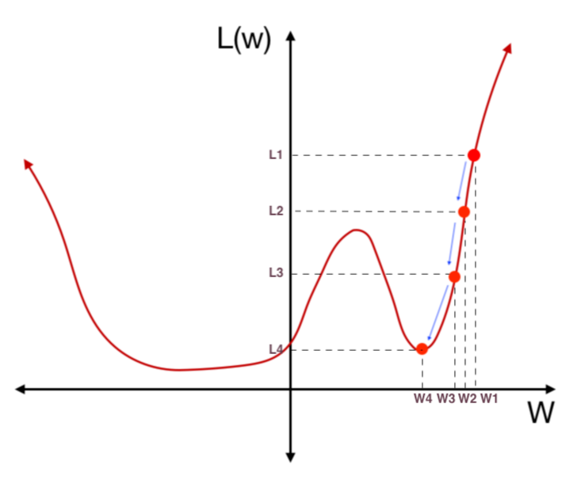
Minimize the loss Using gradient Descent

Slide 34
Benefits of minimizing loss using gradient descent
Improves Model Accuracy: The network learns patterns in the data → predictions get closer to ground truth → accuracy increases.
Systematic Optimization: Gradient descent provides a mathematical direction (via gradients) to reduce errors efficiently instead of random guessing.
Works with Complex Models:Neural networks have millions of parameters. Gradient descent scales well and can handle these high-dimensional optimizations.
Generalization to New Data:A properly minimized loss (with regularization/early stopping) helps the model generalize to unseen data, not just memorize training data.
Convergence to Good Solutions:Gradient descent iteratively moves towards local minima (or good enough optima), ensuring steady improvement in performance.
Efficiency with Large Datasets: Variants like mini-batch gradient descent allow fast convergence while leveraging parallel hardware (GPUs/TPUs).
Flexibility Across Tasks:Different loss functions (cross-entropy, MSE, hinge, etc.) can be plugged in depending on the problem, but gradient descent still works to minimize them.

Slide 35
Review (optional)
Knowing our network and our loss function, how can we tweak the weights and biases to minimize the loss?
35

Slide 36
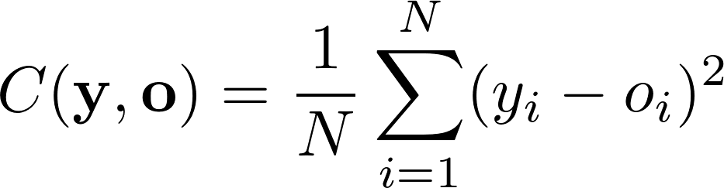
1- What is the Loss (cost) Function …(MSE)
MSE squares the difference between every network output (o) and true label (y), and takes the average
36

Slide 37
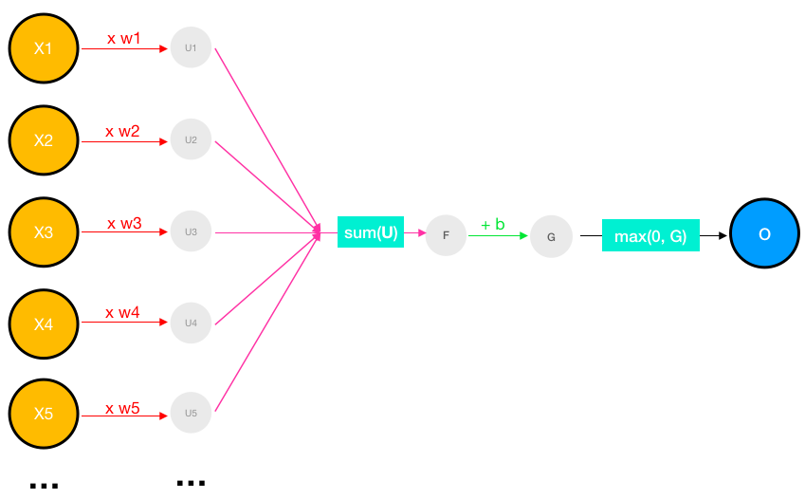
2- What is the activation function used?
A ReLU is simply a function that converts any negative values to 0. Let’s rename that as the max(0,z) function, which returns z if z is positive and 0 if z is negative.
activation(x) = max(0, w ∙ x + b)
activation(z) = max(0, z)
37

Slide 38
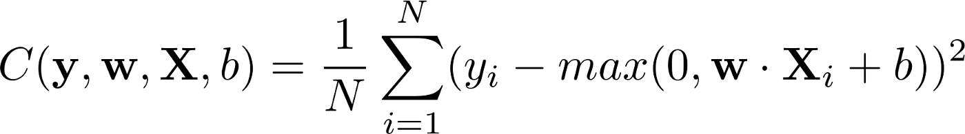
➔The loss function
Capital X (is a vector of input)
What is the slope of the loss function?
38

Slide 39
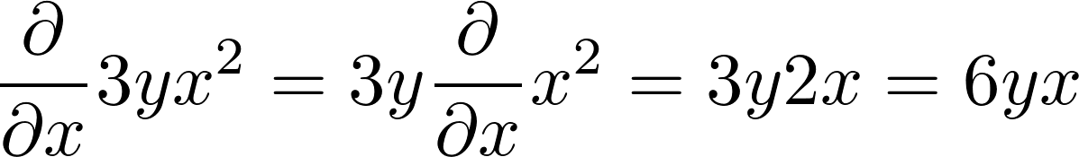
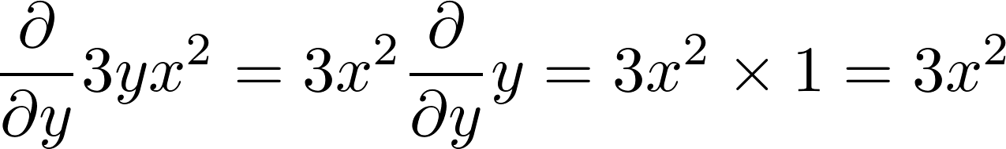
Slope is the derivative of the loss function
With respect to weights w₁, w₂, w₃…, and bias b
Partial derivative example for f(x,y) = 3x²y.
39

Slide 40
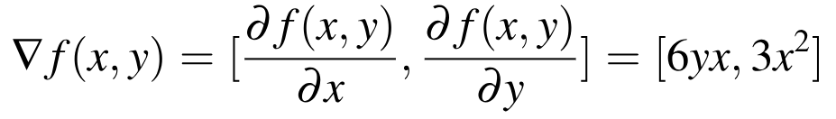
The gradient of the function f(x,y) = 3x²y
is a horizontal vector, composed of the two partials:
the gradient of the function in the x-direction,
the gradient of the function in the y-direction,
40

Slide 41
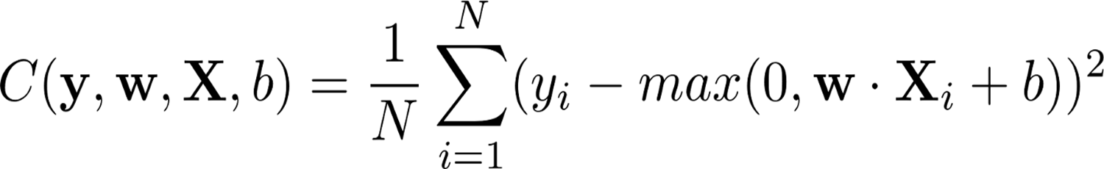
How can we compute the partial derivatives of vector equations?

Slide 42
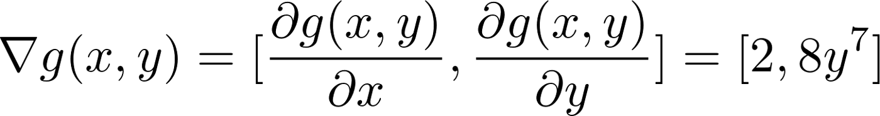
The gradient of the function g(x,y) = 2x+y⁸
is a horizontal vector, composed of the two partials:
the gradient of the function in the x-direction,
the gradient of the function in the y-direction,
42

Slide 43
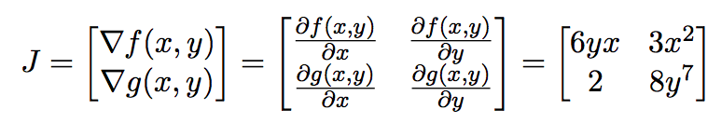
Gradient of a Vector Function :Jacobian Matrix
A neural network with just one layer
A loss function (Mean Squared Error (MSE))
One neuron, numerous weights w₁, w₂, w₃…, a bias b
A ReLU activation
43

Slide 44
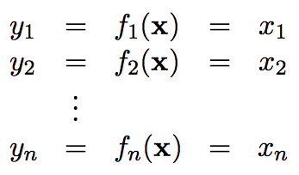
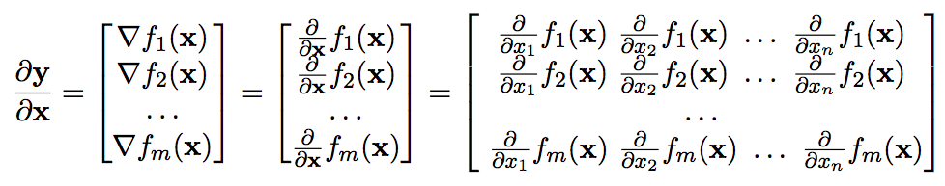
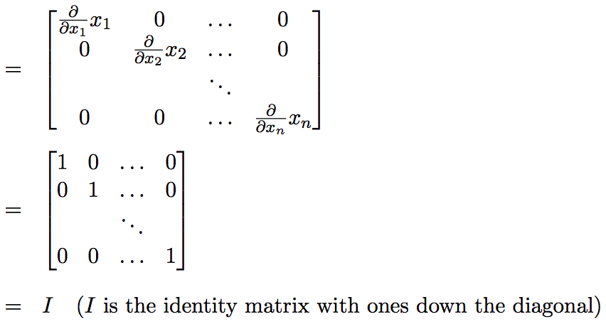
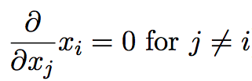
Gradient of the identity function f(x) =x
44

Slide 45



Gradient of vector sum
since the partial derivative of a function with respect to a variable that’s not in the function is zero, it can be further simplified as:
45

Slide 46

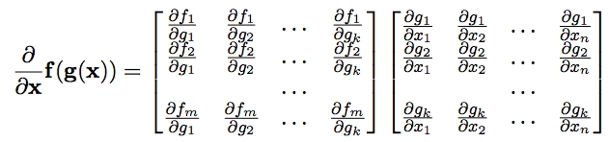
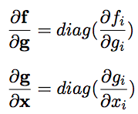
Vector chain rule
Since, each function f matches with
exactly 1 function g

Slide 47

What is the Gradient of A Neuron?

Slide 48

let f(x)=w∙x+b, and g(x)=max(0,x)then
neuron(x)=g(f(x)). (Apply activation function)
➔ use the vector chain rule to find the derivative of this composition of functions
z=f(x)=w∙x+b

Slide 49




What is the partial derivative of z with respect to w? (v=w .x and u=sum(v) 1- derivative of wx 2- derivative of b
49

Slide 50
What is the partial derivative of z with respect to w? (v=w .x and u=sum(v) 1- derivative of wx 2- derivative of b
50

Slide 51
What is the partial derivative of z with respect to w? (v=w .x and u=sum(v) 1- derivative of wx 2- derivative of b
51

Slide 52


What is the partial derivative of z z= u+b
52

Slide 53
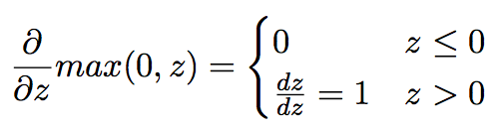
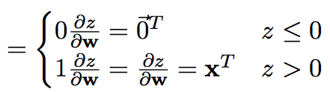
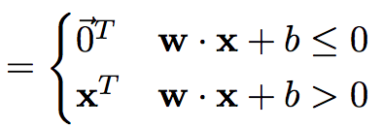
What is the partial derivative of neuron(z) with respect to z?
Neuron(z)=max(0,z)=max(0, sum(w⊗x)+b).
53

Slide 54
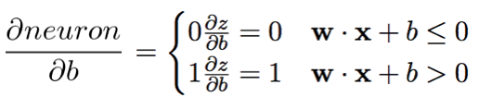
What is the partial derivative of neuron(z) with respect to b?

Slide 55
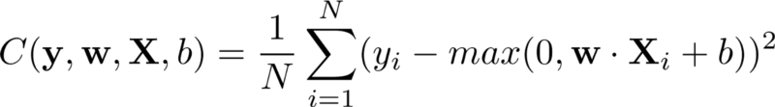

Gradient of Loss Function

Slide 56




Gradient With Respect to Weights

Slide 57





Slide 58


This is the derivative of the loss function

Slide 59

What does it mean ?
ei= w∙x+b-y can be interpreted as an error term
The derivative represents the slope (how much we must move our weights by in order to minimize our error)
If our neural network has just begun training, and has a very low accuracy, the error will be high and thus the derivative will be large as well. Therefore, we will have to take a big step in order to minimize our error.

Slide 60

Subtract current weights with the derivative in order to get one step closer to minimizing the loss function
η represents the learning rate➔The larger the learning rate, the bigger the step

Slide 61





Gradient With Respect to bias

